Slide 1
Council Meeting Executive Director Report November 29, 2022
Aaron Carruthers
State Council on Developmental Disabilities

Slide 2
Overview
Self Determination Statewide Orientation Update
HCBS Letter
Little Hoover Commission
Workload Trends
Admin Update
Gratitude

Slide 3
Self Determination Statewide Orientation Training Update
July 2022 – November 2022
Strong pace
90 Sessions (English 59 / Spanish 30 / Vietnamese 1)
1213 Participants (English 1031 / Spanish 169 / Viet 13)
Good balance
8% Consumer; 65% family and/or conservators; 25% prof
Latinx 12%; White 31%; API 19%; Black 8%; Declined 22%
Strong feedback
95% found information useful
55% Plan to enroll in SDP; 30% Still considering it

Slide 4
Home and Community Based Services (HCBS) Letter
Home and Community-Based Services (HCBS) is name of the federal waiver program that provides funding for services through regional centers
1983, first created by Congress
2014, updated Final Rules released, need to be implemented by states by March 2023.
SCDD created a summary of the Final Rule: Home and Community-Based (HCBS) Final Rule (ca.gov)
Notes:
-Maximizing opportunities and choices for individuals
-Promoting community integration by making sure individuals have full access to the community
-Making sure individuals have the opportunity to work and spend time with other people in their community who do not have disabilities
-Ensuring individual preferences are supported and rights are protected
-Establishing person-centered service planning requirements, which includes a process driven and directed by the individual to identify needed services and supports.

Slide 5
Home and Community Based Services (HCBS) Letter
California process in Strategic Transition Plan (STP)
Status to meeting deadline
Less than half of all service providers self-report they meet all Final Rule requirements
1,700 providers self-report not meet federal requirement “Right to be Treated Well”
Right to privacy, dignity, freedom from coercion or restraint
DDS issued guidance for corrective action plans
Recommendations:
Working group for implementation
Clear appeal process for consumers and providers
Better notice requirements
Administrative law judge training
More detailed corrective action plans for lagging service providers

Slide 6
Little Hoover Commission
Focus
Disparities in service access within the state
Causes of disparities and the current state
Efforts to address disparities
Ways to improve the consistency and timeliness of service delivery
Holding hearings
Oct 13: Hearing Pt 1
Oct 27: Community Roundtable
Nov 10: Hearing Pt 2
Dec 8: Hearing Pt 3 (special hearing)

Slide 7
Little Hoover Commission
Dec 8: Hearing Pt 3 (special hearing)
Aaron Carruthers (SCDD ED only speaker on agenda) comments:
For answers, listen to the community
Find the true scope of racial disparities
Focus on the $12 billion, not just $11 billion
Leverage SCDD’s independent role to connect with the community
Provide advocacy supports again
Public comment
You are welcome to join to make public comment too

Slide 8
Workload Trends: Community
PPE/Vaccine work got us in touch with people who have been disconnected, unengaged, under served, unserved
Over past 10 years:
Working with individuals up 4,500%
Training up 705%
Overall impact up 1,412%
Budget flat (with cost increases)
Staff positions down 7%

Slide 9
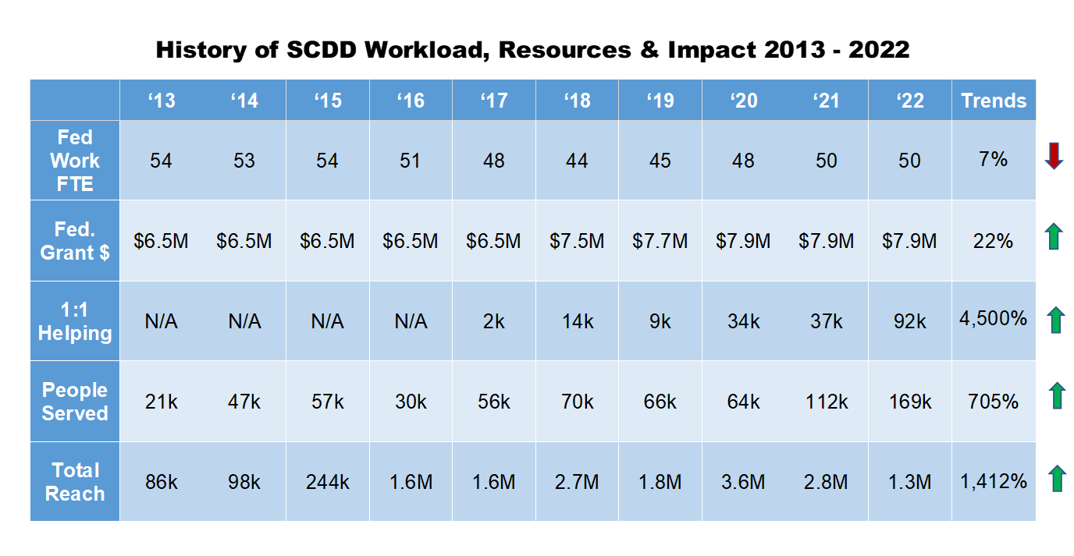
Workload Trends: Community

Slide 10
Workload Trends: Sacramento
Over past 10 years:
Policy success means more work
Needs from Sacramento also increasing workload

Slide 11
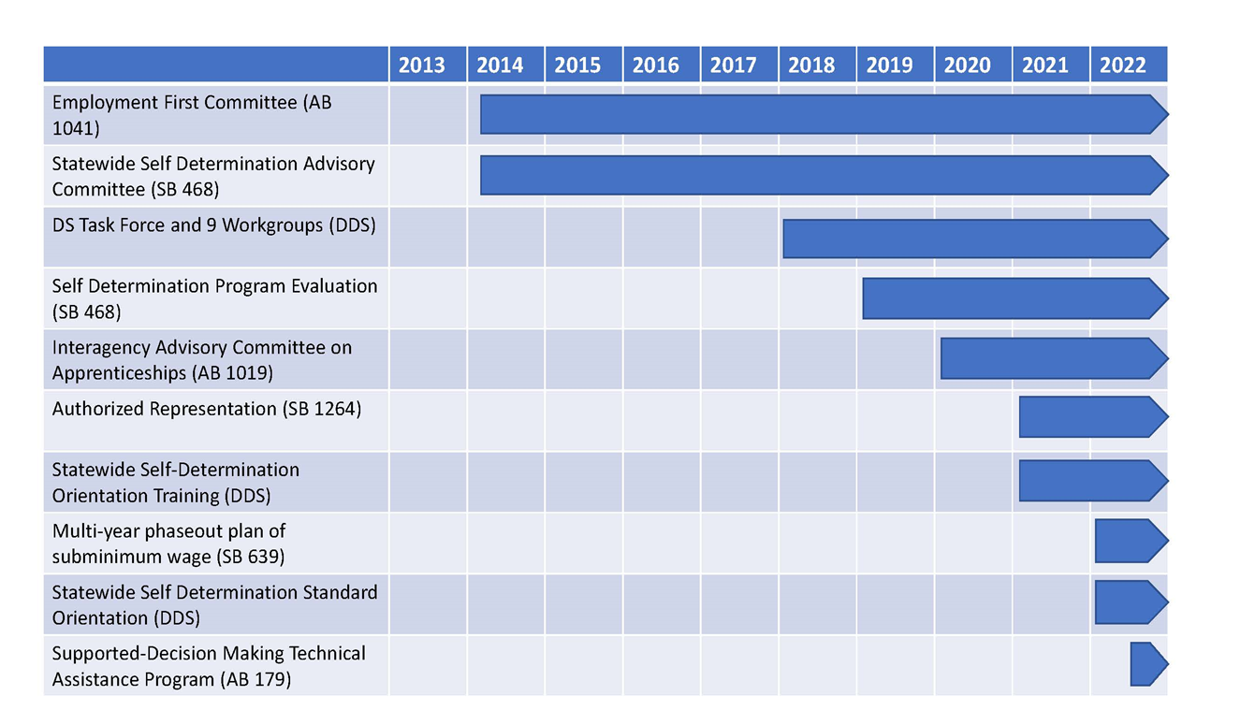
Workload Trends: Sacramento

Slide 12
Workload Trends: Conclusion
Take away: great value of SCDD both in community and Sacramento
Using data for management decisions
Increase funding to meet community and Sacramento needs
Will update Council on recommendations

Slide 13
Administrative Updates
Budget
SCDD budget remains strong, plans built in for rocky times
Org Chart
Requested and provided with report
News Clips
Continued thanks to Michelle Cave
Welcome!
Renee Bauer, North State Region Manager
Elsa Casper, HR

Slide 14
Gratitude in Advoacy
At times, each of or own lights dim and is rekindled by a spark from another person. Each of us has reason for deep gratitude for those who have lighted the flame within us.
-Albert Schweitzer

Slide 15
Questions?

