Slide 1
Preparing a Grant Proposal Budget

Slide 2
Acronyms
California State Council on Developmental Disabilities = SCDD
Request for Proposal = RFP
Notes:
There are several frequently used acronyms or abbreviations in this training. Before we get started let’s briefly review them
We will refer to the California State Council on Developmental Disabilities as SCDD
And the Request for Proposals as the RFP

Slide 3
About the Training Modules
What the grant-writing process includes
Guidance to assist in completing the application for SCDD Cycle 45 RFP
Notes:
WHAT IS THE PURPOSE OF THIS TRAINING? WHAT IS IT ALL ABOUT?
This training is designed to help you understand the grant writing process and to provide guidance to help you complete your application for the SCDD RFP for Cycle 44.

Slide 4
Produced by
California State Council on Developmental Disabilities (SCDD)
The University of Southern California (USC), University Center for Excellence in Developmental Disabilities (UCEDD)
The Tarjan Center at the University of California Los Angeles (UCLA)
The Center for Excellence in Developmental Disabilities at the MIND Institute (CEDD), University of California Davis (UCD)
Notes:
The training is produced and presented by
The Tarjan Center at the University of California Los Angeles.
The University of Southern California (USC) University Center for Excellence in Developmental Disabilities
The Center for Excellence in Developmental Disabilities at the MIND Institute, University of California Davis.
And is sponsored by SCDD

Slide 5
This project was supported in part by Grant #23CASCDD from the U.S. Administration for Community Living, the Department of Health and Human Services, Washington D.C. 20201
Grantees undertaking projects with government sponsorship are encouraged to express freely their findings and conclusions. Points of views or opinions do not, therefore, necessarily represent ACL policy.
Grant Cycle 45 (2022-23)

Slide 6
DISCLAIMER
This is not a substitute for participating in the pre-bidder’s conference call
Viewing these modules will not provide you with an advantage in the grant review process
This will not answer questions about your specific proposal
Notes:
PLEASE NOTE that…
this training is not a substitute for viewing the online modules or participating in the pre-bidder’s conference call
participating in this training doesn’t advantage you in the grant review process (you don’t get extra points just for taking this training, however you may get information to help you write a more competitive proposal
We can’t answer questions about your proposal in specific. This means we can’t tell you if you have a good idea, if your budget is reasonable, if someone else has the same idea,

Slide 7
Budget
Grant terms for budgets
Match funds
Budget Detail Sheet
Example
Notes:
There are 4 sections in the Budget Module
In the first section, we discuss important terms used in budgeting
We discuss matching funds - the portion of the funding you are responsible to provide.
We will introduce the Budget Detail Sheet required by SCDD
We will provide an example
At the end of this section, we will summarize how to complete the Budget Detail Sheet in 7 steps.
As with the rest of the proposal, the budget section must be done following the instructions in the RFP. We suggest that you have a copy of the Budget Detail Sheet as you review this module.

Slide 8
Budget Terms
Notes:
We will define important grant terms used in the instructions for completing the budget.

Slide 9
A grant budget:
Is a financial document
Identifies specific project costs
Explains how funds will be spent
Lists other sources of funding
Notes:
What is a grant budget?
It is a financial document, usually written on a spreadsheet.
A grant budget identifies your project costs.
It tells the funder how the money will be spent. For example, the number of staff or supplies for an activity.
Funders vary in the percentage of the total cost that they will contribute to a project. They will want to know your other sources of funding.
Before we go into the details of preparing your budget, there are three important pieces of information that you will need to know:
-The Allowable and Non-Allowable Costs
-Whether your project serves a Poverty or Non Poverty Area
-And “the Matching Funds.”

Slide 10
Allowable Costs: Federal and State
Staff and consultants; office supplies; printing; rental space; modification of facilities for fire marshal or safety requirements, and insurance
Less than $500 for equipment purchase or rental
Notes:
There are allowable and non- allowable costs to consider as you develop your budget. These are the costs that you can and cannot include in your budget.
They are typically explained in the RFP by the funder.
As a CA state agency that receives federal funds, SCDD must follow both federal and state budgeting rules for allowable and non-allowable costs and reimbursement rates
ALLOWABLE Costs include - Staff and/or consultants to carry out project activities; printing; rental space, and office supplies.
You may also use funds to modify facilities to meet fire marshal or safety requirements, pay for insurance coverage and purchase or rent equipment with a value of less than $500.
If your project includes travel, including mileage, you must use California state reimbursement rates. Directions for where you can find the California state rates can be found in the RFP.

Slide 11
Non-Allowable Costs
The purchase of:
Property
Motor vehicles
Childcare vouchers or services
Food and/or beverages
Computers (without prior written approval from SCDD)
Facility equipment that cannot be removed after the project period ends
Travel outside of California
**Note: This is not a complete list; please refer to the RFP for more information.
Notes:
NON-ALLOWABLE Expenses include: Purchasing property, childcare vouchers, food, motor vehicles, computers without prior approval from SCDD, equipment on a car or facility that cannot be removed after the project period, and travel outside of California.
A common mistake by applicants is to include food and beverages in their budgets. Neither of them are allowable costs.
If you have any questions about the allowable or non-allowable costs, contact the SCDD Contract Analyst, Kristie Allensworth. Her contact information is listed on the RFP.

Slide 12
Poverty and Non-Poverty Areas
Poverty Area: greater than 20% of the residents live below the poverty level
See: Exhibit A, ‘California Poverty Areas by County’
Notes:
As part of your application you are asked to identify whether your project will serve a Poverty or Non-Poverty County as defined by the Federal Government.
A Poverty Area is when 20% or more of the population lives below the poverty level.
Exhibit A is a document provided with the RFP that lists all CA counties by their poverty level.
For example, in Alameda County, 12% of the population lives below the poverty level; therefore this county is considered a NON-POVERTY AREA.
In Merced County, 24% live below the poverty level; therefore, the population is considered to be living in a POVERTY AREA.

Slide 13
Where to use this information
Describe the target population in the ‘Project Narrative’ form
Calculate the required match or project cost for the budget
Notes:
You will use the information about the poverty level in the county you will serve in two ways.
First, to describe your target population in the project narrative and
Second in your budget to calculate the match for the total cost of the project. We will now discuss Matching Funds

Slide 14
Matching Funds
Notes:
We define Matching Funds and how to calculate them. We then use an example to show you how to verify if you have budgeted the correct amount of funds.

Slide 15
What is a Match requirement?
The ‘match’ is the non-federal share of the costs that you and/or your collaborators are required to contribute to accomplish the purposes of the project.
Notes:
Simply put, the ‘match’ is a portion of the costs that you or your collaborators are required to contribute toward the project.
One reason the government likes to include matching funds, is so that you are thinking about how you will sustain the project past the life of the grant.

Slide 16
Where are ‘Match’ funds found?
Match funds may be contributed by the applicant or project collaborators. Match funds may be:
  CASH (an actual expenditure)
  or
  IN-KIND (non-cash)
Notes:
You will have the option of providing a cash match or in-kind contribution to meet the requirements of the match.
The cash match or in-kind match may come from you or one of your collaborating partners.
A cash match is an actual cash contribution. Something that is paying paid for such as staff time, supplies, or services.
In-kind is a non-cash match, such as personnel, goods or services that are donated toward the work of the project and measured in terms of their value.
Where does the match come from? What Is included in either a cash or in-kind match. These are the questions we will now answer.

Slide 17
‘Match’ funds are:
  Either Cash or In-Kind support
  Non-federal, public or private funds
  Funds not being used as ‘match’ for other federal grants
Notes:
Your match may include:
Non-federal public or private funds
Funds that are not used as a match for other federal grants and
Can be in the form of either Cash or In-Kind
We will now describe Cash and In-Kind Support in more detail

Slide 18
Cash Match
A cash match is an actual cash contribution from:
  Personal or agency funds or donations
  One or more collaborators (project partners)
  Other allowable (non-federal) grant funds
Notes:
Cash is the the most common and easiest way to keep track of a match.
A cash match is an actual cash contribution from:
Your own funds, from a donation or collaborator on the project.
You may also use Funds from another grant source that allows you to use their funds as a match
Please note, you may NOT use other federal grant funds as a match

Slide 19
In-Kind Match
Typically comes from the individual or grantee organization in the form of (the value of) staff or volunteer time, goods and/or services
This may include the value of donated office or training space, travel expenses to/from meetings, etc.
Notes:
In-kind match contributions typically come from the grantee organization or collaborators as staff or volunteer time, goods or services.
Goods would be items that you will use during the project year – such as office supplies.
Services could be from a translator or graphic designer.
An in-kind match may include such things as the value of donated space that you use for your project or travel costs to and from meetings
You may have to estimate the cost of in-kind items. For example, if you are using volunteers, you estimate the average amount of money that would be paid for someone doing that job.

Slide 20
What is the project’s Match requirement?
The percentage of matching funds depends on whether the project is serving a Poverty Area (15%) or Non-Poverty Area (25%)
The amount is based on a percentage of the ‘Total Project Costs’
Notes:
To determine the amount of support you are required to provide you first need to know whether or not your project serves a Poverty or Non Poverty Area.
We discussed how to use Exhibit A to find this information.
You are responsible for a 15% Match if you serve a Poverty Area and 25% in a Non-Poverty Area.
This percentage is calculated from the Total Project Costs.
What is the Total Project Cost? How is it Calculated?

Slide 21
Calculating total project costs (1 of 3)
SCDD FUNDS
+ MATCHING FUNDS
= TOTAL PROJECT COSTS
Notes:
To calculate the Total Project Cost you add together the amount of funds that you are requesting from SCDD and the amount you are contributing in matching funds.
As we previously stated, If you are serving a Non Poverty Area you are responsible for 25% of the Total Project Cost and for Poverty Areas 15%
To check if you provided the correct amount of Matching Funds, you multiply the Total Project Costs by your required 15 or 25%. The result should equal the amount of dollars you had listed as Matching Funds

Slide 22
Calculating total project costs (2 of 3)
15%
x TOTAL PROJECT COSTS
= Required Match
** Note: This calculation is for a Poverty Area
Notes:
To calculate the Total Project Cost you add together the amount of funds that you are requesting from SCDD and the amount you are contributing in matching funds.
As we previously stated, If you are serving a Non-Poverty Area you are responsible for 25% of the Total Project Cost. For Poverty Area, provide 15%
To check if you provided the correct amount of Matching Funds, you multiply the Total Project Costs by your required 15 or 25%. The result should equal the amount of dollars you had listed as Matching Funds

Slide 23
Calculating total project costs (3 of 3)
25%
x TOTAL PROJECT COSTS
= Required Match
** Note: This calculation is for a Non-Poverty Area
Notes:
To calculate the Total Project Cost you add together the amount of funds that you are requesting from SCDD and the amount you are contributing in matching funds.
As we previously stated, If you are serving a Non Poverty Area you are responsible for 25% of the Total Project Cost and for Poverty Areas 15%
To check if you provided the correct amount of Matching Funds, you multiply the Total Project Costs by your required 15 or 25%. The result should equal the amount of dollars you had listed as Matching Funds
Let’s look at an example - the Ruby Red Organization

Slide 24
Keep records of Match funds
Keep track of:
Timesheets, receipts, etc.
Reasonable costs for donated services and goods for in-kind or cash match
Record the source of all Match funds on the budget
Notes:
You will need to keep track of your in-kind or cash match by using timesheets, receipts, etc.; and documenting reasonable costs for donated services and goods.
SCDD expects that you will keep this information as part of your financial records. Should SCDD request to see this documentation, you will have it.
On the SCDD Budget Detail Worksheet you are asked to state the source for your matching funds. Remember, matching funds cannot be from federal funds!
We will discuss the Budget Detail Worksheet in the next section

Slide 25
The Budget Detail Sheet
Notes:
We will discuss The Budget Detail Sheet. This worksheet is a required form of the SCDD grant application and is included as an attachment with the RFP. In the RFP it is also called Budget Detail Sheet.

Slide 26
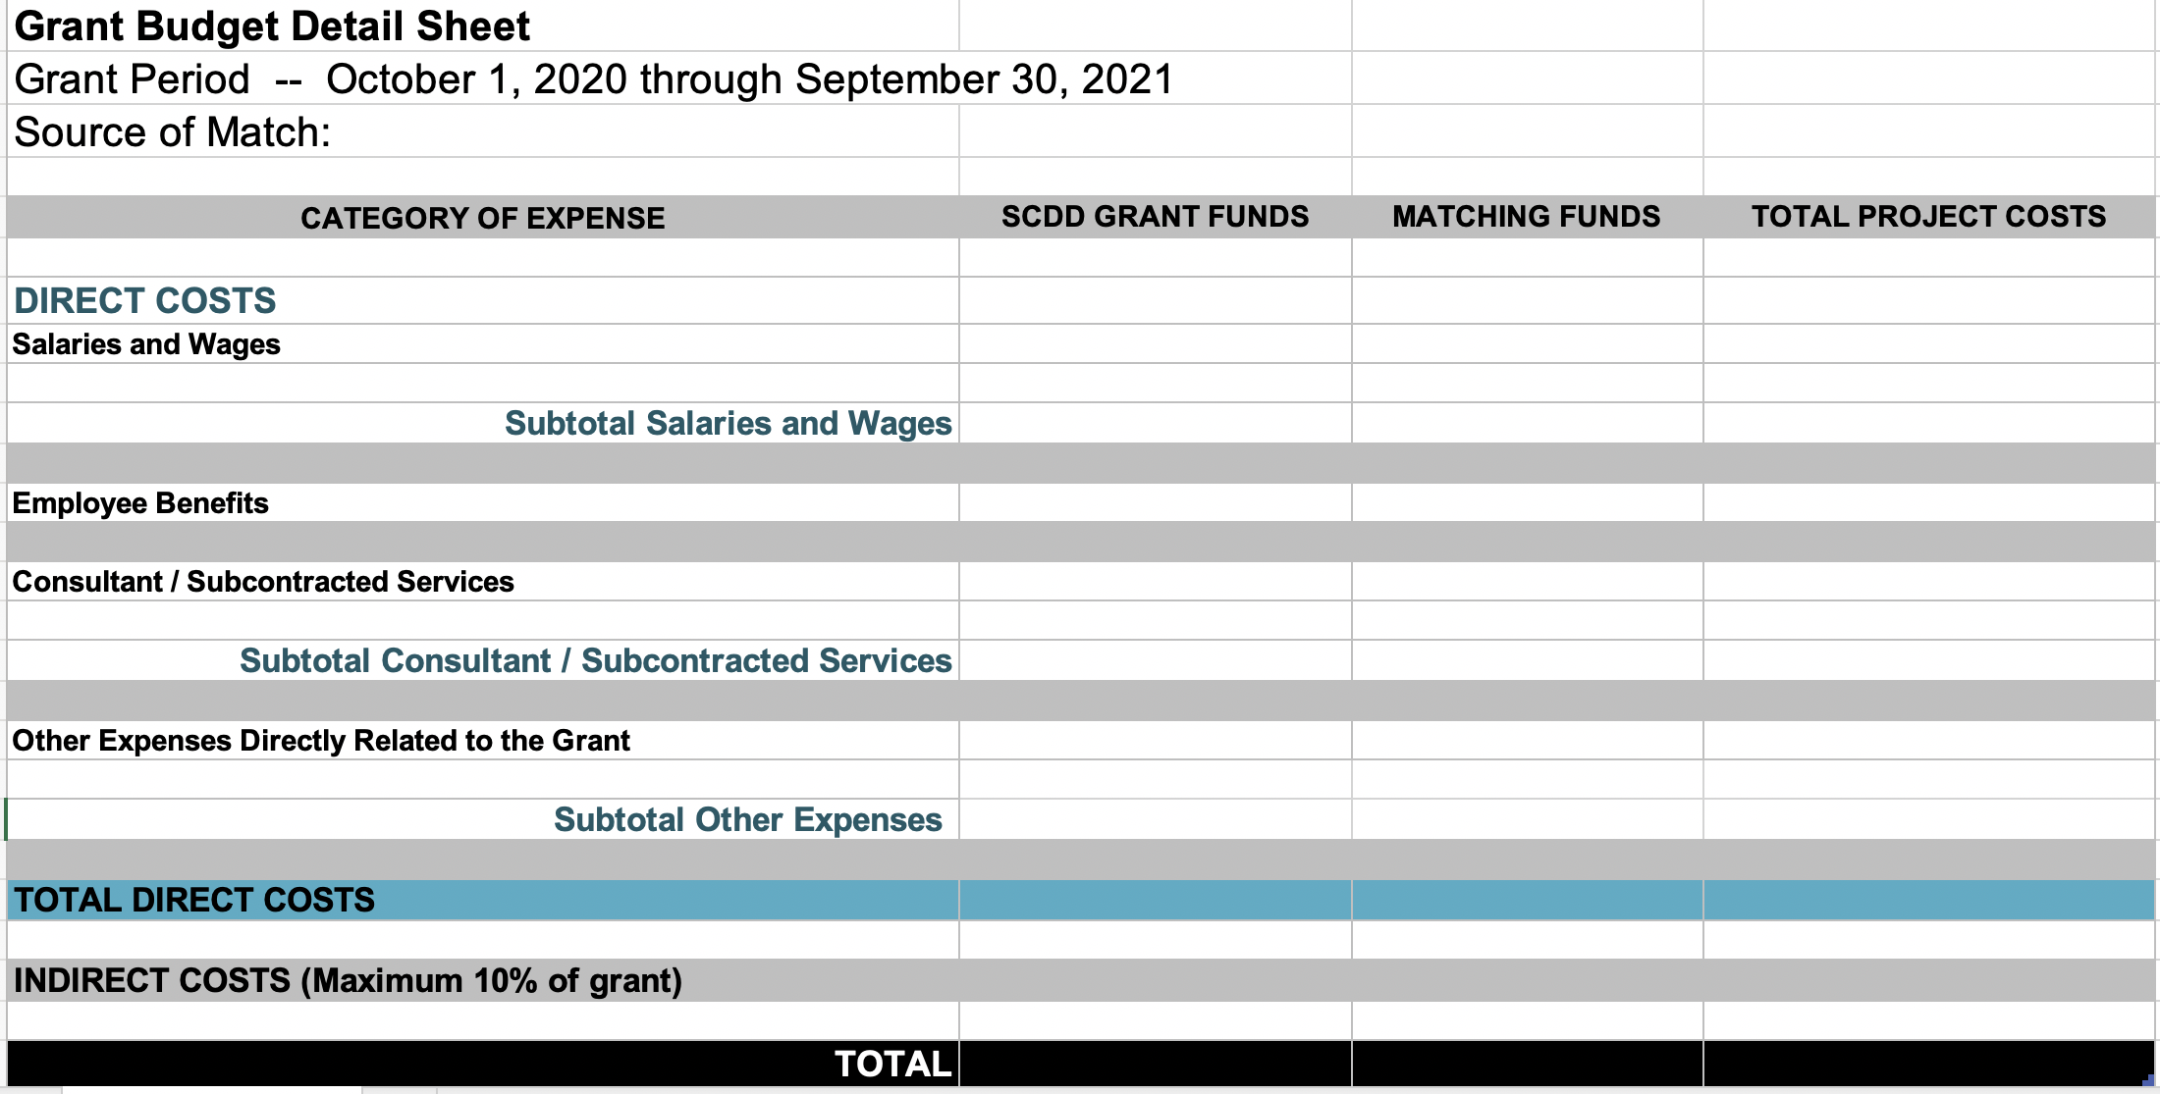
Grant Budget Detail Sheet
Notes:
The actual grant period for Cycle 45 is from October 1, 2022 through September 30, 2023. This is an example from Cycle 43
Let’s review the different parts of the Grant Budget Detail Sheet.
There are 4 Columns along the top of the sheet from left to right, the CATEGORY OF EXPENSE, SCDD FUNDS, MATCHING FUNDS and TOTAL PROJECT COSTS.
The rows of the Budget Detail Sheet are organized into 3 sections Direct Costs, Indirect Costs, and Total Costs.
The first section is for your direct costs. This section has 4 subsections (not every section may apply to your project proposal)
Salaries and Wages,
Employee Benefits,
Consultant and Subcontract Services and
Other Expenses
Below these 4 subsections is a row for the Total Direct Costs by Funding Source - SCDD Grant Funds and Matching Funds and for the combined Total Project Costs.
The budget sheet automatically calculates the line item contents of the rows and columns except for the indirect costs. You will need to manually insert those dollars.

Slide 27
Budget line items
Example: Salary and Wages
Training Specialist 25% at $45,000 =$11,250
Example: Other Expenses
Printing 505 bi-fold pamphlets @ $2.22 = $1,120
Notes:
Let’s take a look at 2 line-item expenses.
Say that your project requires a training specialist. This would be a cost you would list under salary and wages.
You would list the functional title of the staff member, in this case a training specialist,
the percent of time she will dedicate to the project -25% ,
And her total annual salary of $45,000
The total amount of the request is $11,250
Let’s also say your project is going to create pamphlets to go along with the training. This expense would fall under "other expenses'
You have researched the cost of the pamphlets and found that they will cost $2.22 each. Based on the number of participants, you will need 505 pamphlets. You enter this information into your budget sheet for a total of $1,120

Slide 28
Indirect costs:
Are necessary for your organization (not specific project)
Are listed on the budget as a ‘lump sum’
Are limited to 10% of the total direct costs
Notes:
Indirect costs are expenses that are needed by your organization such as the a bookkeeper, liability insurance, building maintenance or technology.
You do not need to list or describe these costs. They are listed as a lump sum under Indirect Costs
The indirect cost is calculated as a percentage of total direct expenses. Therefore you NEED to calculate your total direct costs before you can compute your indirect costs.
SCDD has limited or ’capped’ the indirect costs to 10% of the Total Direct Costs for the project.
Now that we have reviewed the different parts of the Budget Detail Worksheet, in the next module we will take a look at an example of a completed Budget Worksheet

Slide 29
An Example: Ruby Red
Notes:
We will now review the Budget Detail Sheet of a fictitious organization, Ruby Red.

Slide 30
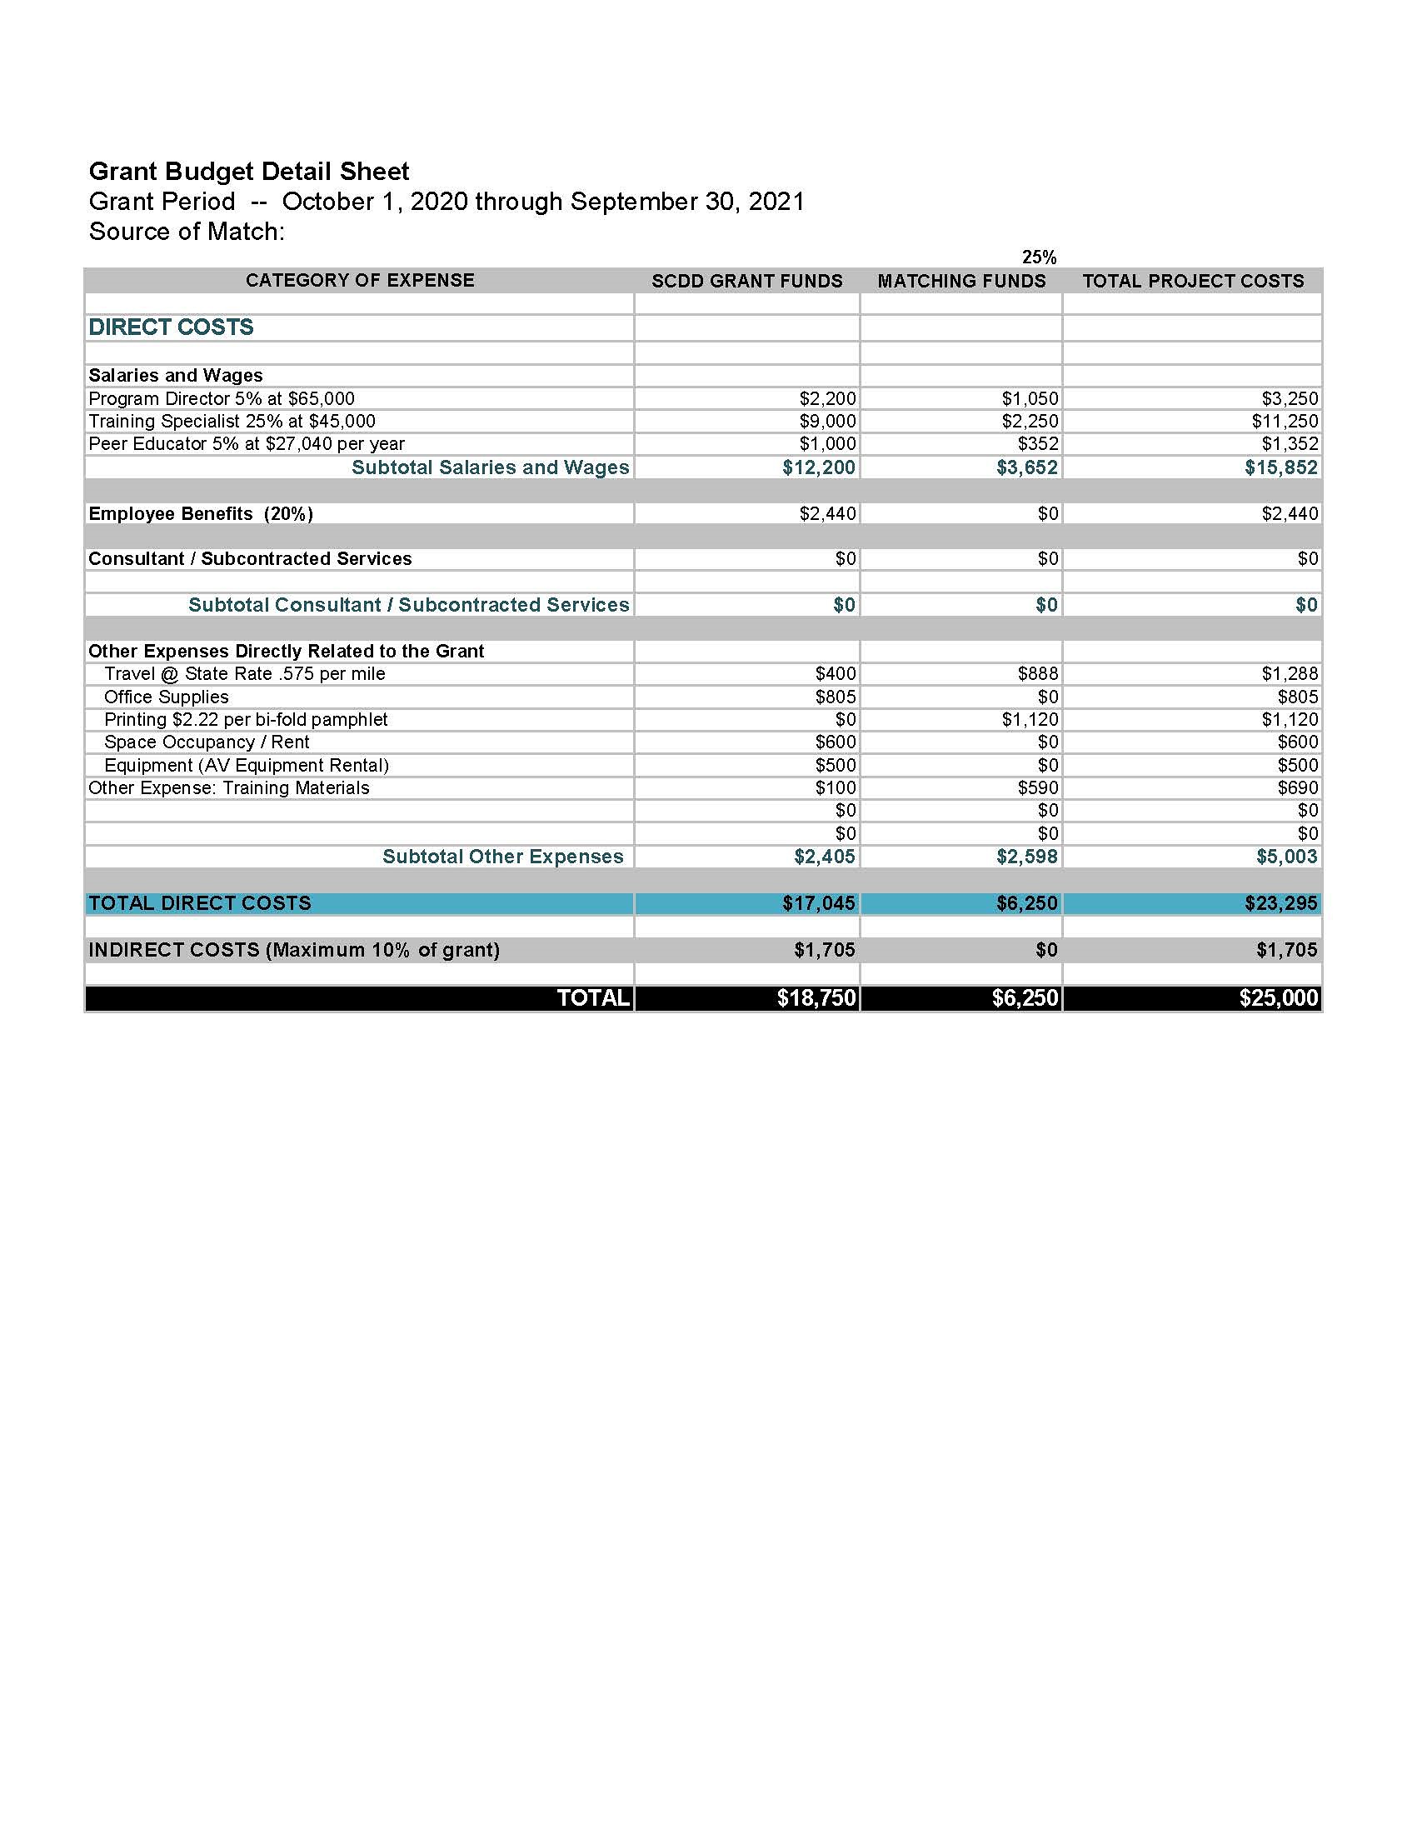
Direct Costs: Salaries and Wages
Notes:
Here is Ruby Red’s completed Grant Budget Detail Sheet that is ready for submission as part of their SCDD Grant Application Package. Let’s take a look at how they completed the different sections of the budget.
First you will see that they listed each individual expense under the correct subsection of Direct Costs. As a reminder, there are 4 subsections under Direct Costs, Salaries and Wages, Employee Benefits, Consultant and Subcontract Services and Other Expenses
Let’s first take a look at the section where there is a blue rectangular box outlining the personnel listed under Salaries and Wages.
Ruby Red listed 3 staff members as line-items under Salaries and Wages. For each staff member, their functional title, percentage of time dedicated to the project and salary are listed.
For example, the Project Director was listed at 5% of her annual salary of $65,000. That comes to a Total Project Cost of $3,250
Ruby Red is requesting $2200 of the salary of the Project Director be provided by SCDD GRANT FUNDS and that they provide $1,050 in Matching Funds. The Total Cost for the Project Director $3.250.

Slide 31
Direct Costs: Other Expenses
Notes:
Now let’s take a look at the Blue Rectangular box surrounding the Other Expenses Section of their budget.
Here Ruby Red listed travel, office supplies and equipment as their line item costs.
The 2021 mileage reimbursement rate for California is 56.0 cents per mile.
Ruby Red is requesting $400 be provided by SCDD GRANT FUNDS and that they provide $888 of Matching Funds for a Total project cost of $1,288.

Slide 32
Indirect Costs
Notes:
Now let’s look at the blue rectangular box surrounding the row with the Indirect Costs. Remember this section is not itemized, you just ask for one lump sum and the amount is capped to 10% of the Total Direct Costs. Ruby Red is requesting a total of $17,405 in Direct Costs from SCDD. They correctly calculated their 10% indirect costs of $1,705.

Slide 33
Total Project Costs
Notes:
The very last row of the Grant Budget Detail Sheet highlighted by the blue rectangular box is the Total Cost for all Direct and Indirect Costs by funder –SCDD Grant Funds total $18,750 and the Matching Funds $6,250.
Added together they equal $25,000. the Total Project Cost.
The last thing that Ruby Red needs to do is verify that they provided the correct amount of funds for their Matching Funds.
As a reminder, the percentage of match depends on the Total Project Costs and whether the project serves a Poverty or Non Poverty Area.
Ruby Red is serving a Non Poverty community and is required to contribute a 25% Match. Their Match Contribution of $6,250 does represent 25% of the Total Project Cost.
The Ruby Red budget is ready to be submitted as part of thir grant application package!

Slide 34
The Budget Detail Sheet in 8 Steps
Review the Allowable and Non-Allowable costs in the Cycle 45 RFP before creating a budget
Determine the appropriate Match requirement. See Exhibit A for the list of Poverty (15%) and Non-Poverty (25%) rates
Notes:
We developed a 8-step guide that walks you through all that you need to do to create your budget. If you are uncertain how to complete of any of steps, go back and review the previous budget module sections
Let’s take a look at each step.
First you will review the allowable and non allowable costs in the RFP.
Second, you will determine the Match requirement by identifying in Exhibit A whether the county you will be serving in is a Poverty or Non Poverty Area.

Slide 35
The Budget Detail Sheet in 8 Steps
List all Direct Costs in a line-item list by Category of Expenses
List all expenses by the source of that funding (SCDD GRANT FUNDS or MATCHING FUNDS)
Calculate the total Direct Costs
Calculate Indirect Costs @ 10% of Direct Costs
Notes:
Third, you List all Direct Costs in a line-item list by Category of Expenses
Fourth, you List all expenses by the Source of Funding (SCDD GRANT FUNDS or MATCHING FUNDS)
Fifth you Calculate the total Direct Costs. The SCDD Budget Detail Sheet will do the calculations for you.
Sixth, Calculate the Indirect Costs@ 10% of Direct Costs. You will need to do this manually and insert it into your Budget Detail Sheet

Slide 36
The Budget Detail Sheet in 8 Steps
Calculate Total Project Cost (All SCDD Grant Funds plus Matching Funds)
Check that Matching Funds meet the match requirement (25% or 15%)
The budget is ready to be submitted!
Notes:
7th, you will calculate the Total Project Cost by adding together the requested funds from SCDD and the matching Funds.
8th you will check that your matching funds meets your match requirement of 25 or 15%.
Your budget is now ready to be submitted!
This concludes the Budget Modules for Preparing a Grant Application for the California State Council on Developmental Disabilities.

