Slide 1

March 26, 2019
DAY 1
AGENDA

Slide 2

10:00 a.m
Call to Order: Nicole Patterson, Chairperson
Welcome: Nicole Patterson, Chairperson
Roll Call: Lisa Cooley, Secretary

Slide 3

Review and Approval of Agenda
Nicole Patterson, Chairperson
Desiree Boykin, Vice Chairperson
Lisa Cooley, Secretary
ACTION

Slide 4

PUBLIC COMMENT

Slide 5
Review and Approval of Minutes December 2018
Nicole Patterson, Chairperson
Desiree Boykin, Vice Chairperson
Lisa Cooley, Secretary
ACTION

Slide 6
Updates from the Chair

Slide 7


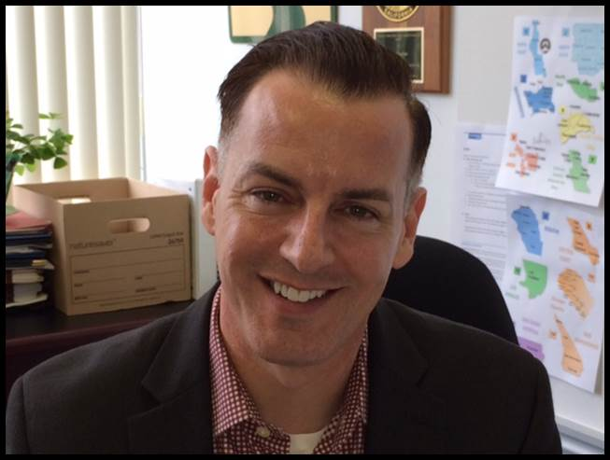
SCDD UPDATE
Aaron Carruthers
Executive Director
See Pages 27-29

Slide 8

Legislative Update
Presented by
Aaron Carruthers
SCDD Executive Director

Slide 9

SSAN Workgroups
See Pages 33-40

Slide 10
LUNCH on your own
Break is 90 minutes

Slide 11
Review and Approval of Updates to SSAN By-Laws
See Pages 41 – 65 of the SSAN Packet

Slide 12

Bylaws
Statewide Self-Advocacy Network (SSAN)
A project of the State Council on Developmental Disabilities

Slide 13
Article 1: Name, Purpose and Description
Section 1 – Network Name
Statewide Self-Advocacy Network (SSAN)
Section 2 – Network Purpose
The Statewide Self-Advocacy Network (SSAN) promotes leadership and builds bridges that strengthen advocacy among disability communities by focusing on policy change.

Slide 14
Section 3 – Description
SSAN is a cross-disability network of self-advocates that was established in 2012 and works to do the following:
Develop the knowledge and skills to make a difference in our region and state.
Speak up for all people with disabilities.
Learn about and advocate for issues important to all people with disabilities.

Slide 15
Section 3 – Description (cont.)
Lead regional and statewide advocacy groups and networks.
Train advocates in their communities in order to grow the Self-Advocacy movement in California.
Share information about programs and supports for people with disabilities.

Slide 16
Article 2 - Membership
Members with disabilities represent regions, organizations, and affiliates in California that are interested in promoting systems change.
Section 1. Makeup:
SSAN membership is made up of Regional Representatives, who represent the SCDD Regional Offices, and Non-Regional Representatives. All members of SSAN are voting members of SSAN. Each member has one vote.

Slide 17
Section 1a - Regional Representative:
Each regional office of the SCDD will have one regional representative on SSAN. In the event that the number of regional offices changes, the SSAN officers may discuss options on how to proceed with regards to the SSAN membership.
Section 1b - Regional Offices:
The regional office representatives will be from the North Coast, North State, Sacramento, North Bay, Bay Area, North Valley Hills, Central Coast, Sequoia, Los Angeles, Orange County, San Bernardino, and San Diego/Imperial SCDD Regional Offices.

Slide 18
Section 1c - Non-Regional Representatives:
Non-Regional Representatives include: Association of Regional Centers Agencies (ARCA), Department of Developmental Services (DDS), University Centers of Excellence in Developmental Disabilities (UCEDDs), Disability Rights California (DRC), and California Foundation on Independent Living Centers (CFILC). Additional organizations may be included as the network expands and grows throughout California.
Section 2. Orientation:
New members will participate in an orientation on SSAN and SCDD with the Chair of SSAN and the SCDD Self-Advocacy Coordinator. New members will receive copies of the SSAN Bylaws and the Memorandum of Understanding (MOU) between the SSAN and SCDD.

Slide 19
Section 3. Attendance:
Members are expected to attend all meetings and inform the SCDD Self-Advocacy Coordinator or Chair of the SSAN if they must miss a meeting. The regional office or sponsoring agency, that the SSAN member represents will be notified by the Chair of the SSAN if their member misses more than two consecutive meetings unexcused.
Section 4. Member Terms:
Members appointed by regional offices shall serve a four-year term. A member may serve an unlimited number of consecutive terms as appointed by their regional office or organization. While SSAN and SCDD cannot direct an organization or department on who their representative to SSAN will be, the SSAN officers may provide input to the organization or department.

Slide 20
Process for Terms is the following:
The SCDD Self-Advocacy Coordinator will monitor and review the SSAN Roster and keep SSAN leadership aware of terms that will expire.
The SSAN Chair and SCDD Self-Advocacy Coordinator will review annually and discuss with any member whose term will expire.
While there are no term limits, the SSAN member can choose to continue for another 4-year term or not to do another 4-year term.
If a member chooses to continue for another term, the SCDD Self-Advocacy Coordinator will update the roster.
If the member chooses not to continue for another term, a plan will be developed to find a replacement. This could include assistance from the regional office, self-advocacy group and the SCDD Self-Advocacy Coordinator.

Slide 21
In the event that a regional representative is unable to complete their current term, the SSAN Officers shall use the SSAN Membership Process to fill the vacant position. The SCDD Self- Advocacy Coordinator will contact and inform the regional office manager of the vacancy and the strategy to fill the position. The new member will start a new term upon selection.
In the event of an agency member being unable to complete their current term, the SSAN Officers shall request the SCDD Self- Advocacy Coordinator to contact the agency to request a new representative. The new member will start a new term upon selection.

Slide 22
Article 3 – Meetings
Section 1. Number of Meetings:
The SSAN will meet no more than four times a year (quarterly) in person. Members may meet in between quarterly meetings to work on projects and as a participant of a workgroup. The SSAN may have regional or special meetings to discuss important issues or presentations, if there is room in the SSAN budget and SCDD approves the request. Meetings shall be noticed and conducted according to the Bagley-Keene Act and Roberts Rules of Order.

Slide 23
Section 2. Quorum and Voting:
Section 2a – Quorum
A quorum for SSAN requires a simple majority (50% plus 1) of the membership. A quorum is needed for the group to take action on SSAN business.
Section 2b – Voting
Each member has one (1) vote and has the authority to vote on issues presented at SSAN meetings. All voting will be by roll call.

Slide 24
Section 3. Workgroups:
SSAN may create workgroups to focus on issues and projects in between SSAN meetings. Workgroups may meet monthly by webcam, telephone, or in-person. Workgroups can be created or dissolved at any time at the direction of the SSAN membership.
Executive
The Executive Workgroup is a standing workgroup made up of the SSAN Chair, Vice Chair and Secretary. This group works with SCDD staff to set the agenda and address any business that may arise between regularly scheduled SSAN meetings.
Ad Hoc
A member can make a motion to create a temporary workgroup if they feel one is needed. An ad hoc workgroup shall have a Chair appointed by the SSAN Chair. Ad hoc workgroup terms and duties are determined by SSAN.

Slide 25
Article 4 – Officers and Elections
SSAN officers will be Chair, Vice-Chair, and Secretary.
Section 1. Eligibility:
All SSAN members may run for the position of Vice-Chair or Secretary. A SSAN member must be a member of SSAN for at least one (1) year before they can run for the position of SSAN Chair.

Slide 26
Section 2. Terms:
A SSAN Officer’s term will be two years. An officer stays in their position until they term out, they are elected to a new office, or they resign. An officer is limited to serving one (1) term per officer position, but may run again for that officer position after sitting out for one term. Members are free to run for any other officer position during that two-year waiting period.
Section 3. Vacancies
The Chair can fill any officer vacancies on a temporary basis until the next meeting. If an officer cannot complete a term, another member will be elected by the SSAN at the next regularly scheduled meeting. That newly elected officer shall serve the remainder of that term, and will be allowed to run for that position for a full term at the next officer election.

Slide 27
Section 4. Duties of Officers:
Section 4a – Duties of the Chair
Work with the Vice Chair, Secretary, SCDD Self-Advocacy Coordinator, and other support staff to prepare meeting agendas.
Represent SSAN in the community.
Work with SSAN members to follow up on issues brought up at meetings.
Work with SSAN support staff in between meetings.
Communicate as needed with SSAN members in between meetings while following the Bagley-Keene Act.
Know and implement the SSAN bylaws.

Slide 28
Section 4b – Duties of the Vice-Chair:
Work with the Chair, Secretary, SCDD Self-Advocacy Coordinator, and other support staff to prepare meeting agendas.
Perform all duties of Chair in absence of Chair.
Have ongoing communication with the Chair before each meeting while following the Bagley-Keene Act.
Assist Chair to follow up on issues brought up at meetings.
Act as timekeeper

Slide 29
Section 4c – Duties of Secretary
Work with the Chair, Vice Chair, SCDD Self-Advocacy Coordinator, and other support staff to prepare meeting agendas.
Perform all duties of Vice Chair in their absence.
Perform all duties of the Chair in the absence of the Chair and Vice Chair.
Take roll call to establish quorum.
Works with support staff to prepare and distribute minutes of meetings.
Keep track of motions, votes and actions at meetings.
Act as parliamentarian.

Slide 30
Section 4d – Expectations of Officers
Attend all SSAN meetings
Attend SSAN officer meetings
Serve as a mentor for new members
Know SSAN bylaws and meeting procedures
Help support workgroups

Slide 31
Section 5. Election of Officers
The SSAN will nominate and vote for their officers. Elections will be held at the first SSAN meeting following October 1. The new officers will take office immediately after the election is complete.
Section 5a – Nominations
Nominations will be made on Day 1 of the meeting.
Members cannot nominate themselves. Another member must nominate them and that nomination must be seconded.
The nominee has the right to accept or refuse the nomination.
Section 5b – Speeches
Speeches will be done on Day 2 of the meeting.
Each candidate will have five (5) minutes to give a speech. If there are 10 or more candidates for all offices combined the SSAN members may vote to reduce the time limit.

Slide 32
Section 5c – Voting
Voting shall be by roll call.
All members get one (1) vote, including the Chair.
If there is a tie, there will be a run-off election, without speeches, between the top two candidates.
The Chair will not vote in a run-off election. If the run-off election results in a tie, the Chair will break the tie.
The candidates receiving the most votes will hold that officer position for a term of two (2) years.

Slide 33
Article 5 – MOU between SSAN and SCDD
A Memorandum of Understanding (MOU) between SSAN and SCDD was signed in January of 2017 defining the relationship between the SSAN and SCDD. The purpose of the MOU is to clarify the roles, responsibilities and expectations of both groups in order to facilitate a working relationship that benefits both parties.
The MOU will be reviewed every three (3) years from the date last signed. For a copy of the MOU, contact the Self-Advocacy Coordinator at SCDD Headquarters in Sacramento.

Slide 34
Article 6 – Finances
Section 1. Fiscal Year:
As a project of SCDD, SSAN will follow the federal fiscal year for the purpose of the budget. The federal fiscal year begins on October 1 through September 30.
Section 2. Funds:
The funds for SSAN will be maintained by the SCDD in accordance with the MOU. The Self-Advocacy Coordinator will monitor and track SSAN-related expenses. SSAN will receive regular financial updates at the March and September meetings to keep them informed of the SSAN budget.

Slide 35
Article 7 – Amendments
Amendments to these Bylaws require a 2/3 vote of the full SSAN.
Adopted 9/11/2013
Amended 3/9/2017
Amended 3/ /2019

Slide 36

AUCD Conference Recap
Presented by California UCEDDs:
Kecia Weller
  UCLA Tajan Center
Robert Levy
  UC Davis Mind Institute
Wesley Witherspoon
  USC Childrens Hospital

Slide 37
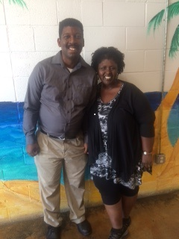
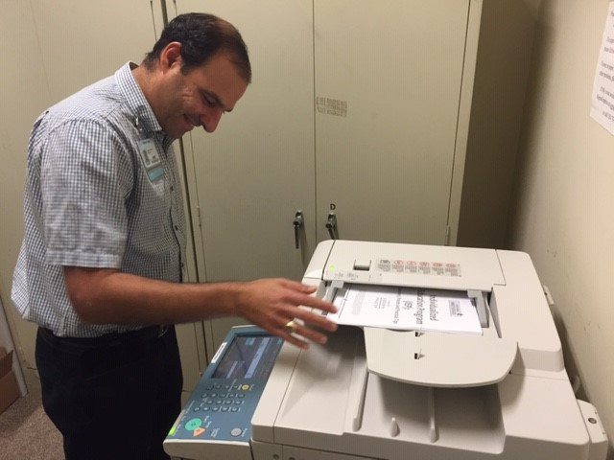
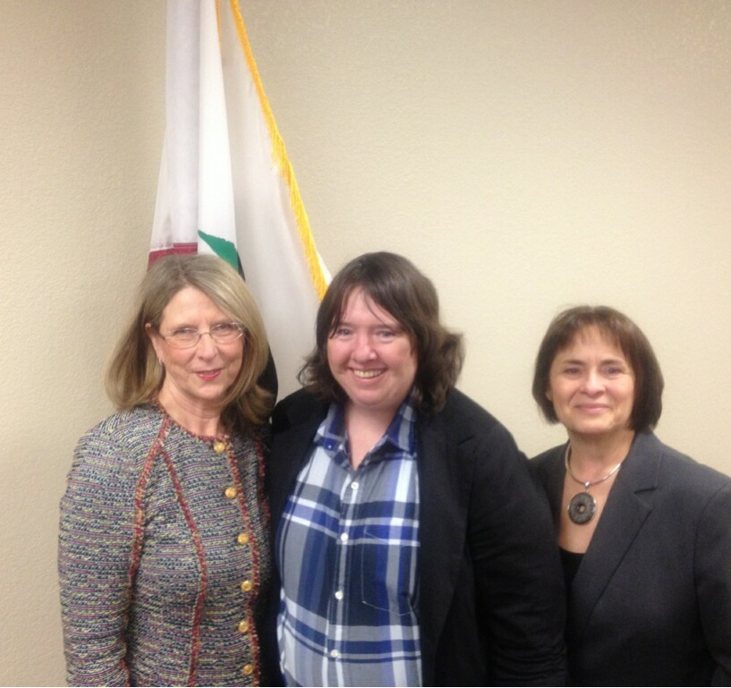
Kecia, Robert, and Wesley working at the 3 California UCEDDs
Wesley provides training in the community for USC Children's Hospital
Robert provides administrative support for the MIND Institute
Kecia speaks with government officials for the UCLA Tarjan Center

Slide 38

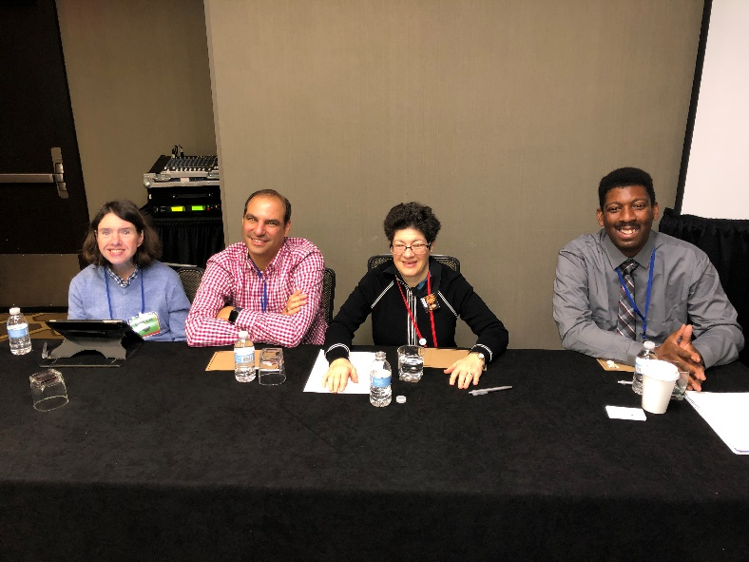
2018 AUCD Conference Washington, D.C. “We All Belong Here”

Slide 39
Why jobs are important to people with I/DD
Inclusion, people with disabilities are included.
A job is a way to having a social life, housing, transportation, etc.
A job gives people a purpose and pride and have a productive life.
Jobs give people a way to earn money.
Independence

Slide 40
Competitive Integrated Employment
What is It?
  Competitive Integrated Employment (CIE) gives People with disabilities the ability to get jobs and work at or above the minimum wage in an integrated setting.
  The CIE Blueprint is an agreement between different departments in California to as a way to promote California’s Employment First Policy
Who is involved?
  Department of Developmental Services, Department of Rehabilitation, Department of Education
Why is it important?
  People can have a productive life and contribute to society. CIE allows people with disabilities to pay their bills

Slide 41
Thank you for listening to our presentation
Are there any questions?

Slide 42
Break

Slide 43
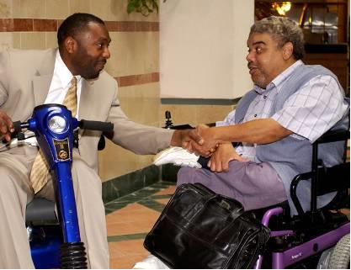
friendsHIPS
And Other relationships

Slide 44
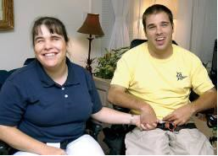
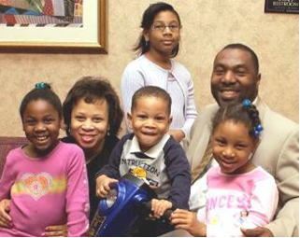
You are around people every day.
You see some people a lot:
Friends
Family
Co-workers
Some are very close to you:
Girlfriends and boyfriends
Husbands and wives
Partners

Slide 45
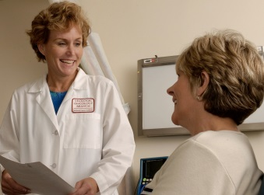

You know other people too.
Some people are not as close to you:
Your doctor
The person who works at the bank
The person who lives next door
As you get to know people better, they may become your friends.

Slide 46


Why are friends/partners important?
A friend is someone with whom you can:
Talk
Have fun
Share your thoughts and feelings with
Without friends, you may feel lonely or sad.

Slide 47


What do friends/partners do for each other?
In a healthy relationship, people:
Talk and listen to each other
Respect each other
Work out problems or disagreements

Slide 48

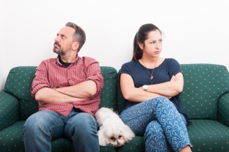

Relationship Types
Healthy
Unhealthy
Abusive

Slide 49

Healthy
What makes a relationship Healthy?
Respect
Good Communication
Trust
Honesty
Equality

Slide 50

UNHEALTHY
What makes a relationship unhealthy?
Pressure
Poor communication
Dishonesty
Struggles for control
Inconsiderate behavior

Slide 51

Abusive
What makes a relationship abusive?
Accusations
Blaming
Isolation or Pressure
Manipulation

Slide 52
Do you have a healthy relationship?
Do you like to spend time with your friend/partner?
Do you feel safe with your friend/partner?
Do you feel good when you are with your friend/partner?
If you said yes to all of these questions…. you should have a healthy friendship?

Slide 53
Do you have an unhealthy relationship?
Do you feel sad, angry, or scared around your friend/partner?
Does your friend/partner say mean things to you?
Do you feel you have to spend time with your friend/partner?
If you said yes to any of these questions… you may not have a healthy relationship.

Slide 54

You can get sick or hurt in an unhealthy relationship.
If you think you have an unhealthy relationship , talk to:
Another friend you trust
A counselor
A case manager
If a friend/partner hits or hurts you tell someone you trust today!
Places to call:
The Center for Community Solutions.
https://www.ccssd.org/get-help/overview.html Hotline 1-888-385-4657
National Domestic Violence Hotline – 1.800.799.SAFE
RAINN (National rape crisis line) – 1.800.656.4673

Slide 55

Healthy Relationship Quiz

Slide 56

Making New Friends
Some people are shy.
That makes it hard to make new friends.
Here are some ideas that can help you take the first step.

Slide 57

Step 1: What is Going On in Your Town?
There are lots of places nearby where you can make new friends.
This worksheet will help you explore your community. Fill it out together with friends or your support staff.
http://ddssafety.net/everyday-life/community/what-do-i-do-worksheet-community-activities

Slide 58
Step 2: What do you like to do?
Make a list of things you like to do.
Ask someone who knows you well for ideas, too.
Where do people go to do these things?
A place (like a video arcade or bowling alley)?
A club (like a train club, gardening club)?
That’s where you will find people who like the same things as you.

Slide 59
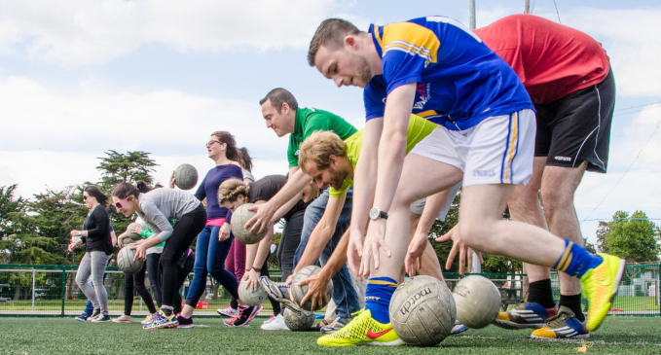
Step 3: Just Go Do It!
What will you try first? A club? A new place you haven't been? A sports event?
Do you need support- like a ride or help filling out a form? Ask!
Do you want someone to go with you? Ask!
Now…Just go do it!

Slide 60


Slide 61
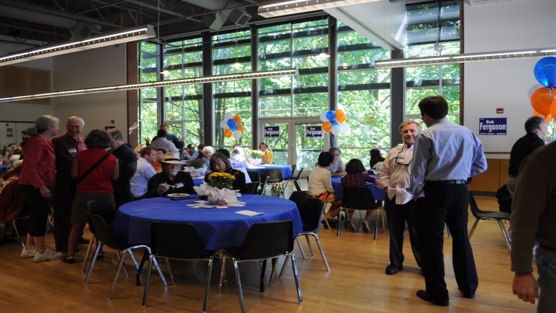
Other Places to Meet People
Ask your support person if there are:
People First meetings in your area
Dances at local recreation centers
Activities at local recreation centers
Volunteer opportunities at local parks, theaters or museums

Slide 62
What if I meet someone I’d like to have as a friend?
Smile!
Say your name and ask for theirs.
Talk about something you enjoy:
“This is a great basketball game”
“Have you seen this movie before?”
Ask questions about the person.
Before you know it, you have a new friend!

Slide 63
Remember:
Everyone needs friends
Everyone deserves healthy relationships
If your relationship is unhealthy, talk to someone you trust
If you are being hurt call someone today
Places to call:
The Center for Community Solutions. Hotline 1-888-385-4657
National Domestic Violence Hotline – 1.800.799.SAFE
RAINN (National rape crisis line) – 1.800.656.4673

Slide 64
Social Networking Safety
When using social networking sites such as Facebook, Twitter, or Instagram, it is important to keep safety in mind.
Privacy settings are important to keep your information only visible to people you know.
Don’t post anything that you might regret.
Examples?
Remember that future employers might look at your page, and inappropriate content might impact your job opportunities.

Slide 65
Relationship Bill of Rights
You have the right to privacy, both online and off
You have the right to feel safe and respected
You have the right to decide who you want to date or not date
You have the right to choose when/if you have sex and who you have sex with
You have the right to say no at any time (to sex, to drugs or alcohol, to a relationship)
You have the right to hang out with your friends and family and do things your enjoy, without your partner getting jealous or controlling
You have the right to end a relationship that isn't right or healthy for you
You have the right to live free from violence and abuse

Slide 66


Slide 67
March Newsletter Approval & Ideas for the Next Edition
March 2019 Issue Contributors:
  Nate Florez – “Meet New SSAN Member”
  Robert Levy – “YouTube Videos and work booklets links resources information”
  Nicole Patterson – “Thinking Ahead My Way, My Life at the End”
  Robert Levy – “SSAN 7th Birthday”
  Teresa Moshier – “Camp Fire Evacuation”
  Wesley Witherspoon and Paul Mansell– “Making Friends and Building Closer Friendships”
  Kecia Weller, Robert Levy and Wesley Witherspoon – “Our Experiences at the Association of University Centers on Disabilities (AUCD) Conference in Washington D.C.
ACTION
See Pages 73-86 of Statewide SSAN Packet

Slide 68
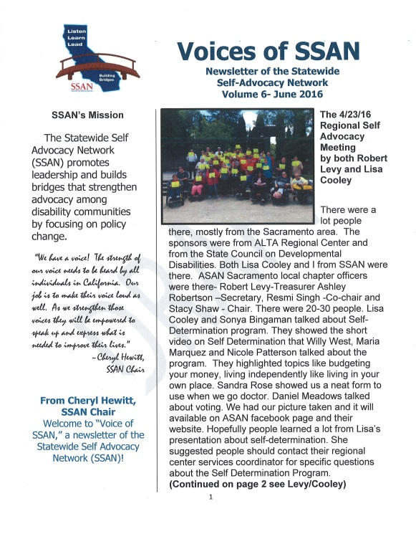
Call for Newsletter Writers
Are you interested in writing an article about past presenters to SSAN?
Please submit them to Robert Levy rj.levy70@gmail.com

Slide 69

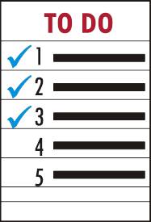
Wrap-Up and Talking Points Day 1

Slide 70

5:00 p.m. Adjourn

Slide 71

GREAT WORK TODAY EVERYONE!
REMINDER
DAY 2 will begin at 9:30am sharp!

Slide 72
March 27, 2019
DAY 2
AGENDA

Slide 73
9:30 a.m.
Call to Order: Nicole Patterson, Chairperson
Welcome: Nicole Patterson, Chairperson
Roll Call: Lisa Cooley, Secretary

Slide 74
PUBLIC COMMENT

Slide 75
SSAN Strategic Planning Session
Presented by Vicki Smith SCDD Deputy Director of Regional Office Operations
See Page 87

Slide 76
Break

Slide 77
SSAN Strategic Planning Session – Continued
Presented by Vicki Smith SCDD Deputy Director of Regional Office Operations
See Page 87

Slide 78
LUNCH on your own
Break is 60 minutes
Please Start the Meeting Evaluations

Slide 79

Disability Sensitivity Training
Presented By Katie Hornberger
Director of OCRA/OPRABA
See Pages 89

Slide 80
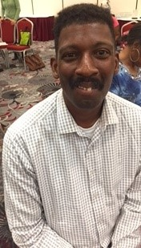
SCDD/SAAC Report
Wesley Witherspoon
Page 91-92

Slide 81


Review Member Action Plan/Assignments
SSAN Officers – Building Networks
Notes:
Handout DRC evaluations

Slide 83

Questions?

Slide 84
Talking Points

Slide 85
Input for next SSAN Meeting
ALL
Please complete the Meeting Evaluations

Slide 86

3:00 p.m. Adjourn
Thanks everyone & Safe Travels

