Slide 1
State Plan Objective # 4.1.3.A Personal Safety
Project of Excellence
In Case of Emergency Cards
North Coast Regional Office
Open House – October 2018
Sheli Wright | North Coast Regional Office

Slide 2
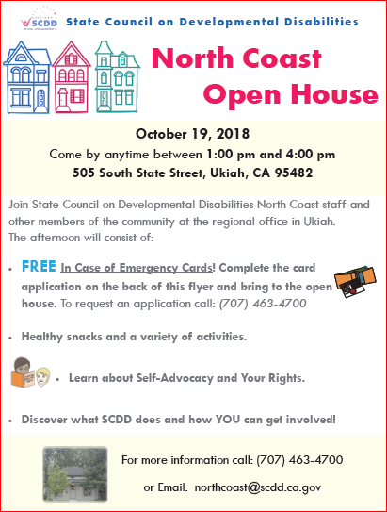
Desired and Achieved Outcome(s) of Activity:
Develop personal safety related material and distribute this information to self-advocates in the community.
IN CASE OF EMERGENCY CARDS - strengthened relationships with law enforcement & emergency responders in the community with advocates & individuals who may have trouble communicating their emergency needs.
Notes:
On October of 2018, the North Coast Office had an Open House in order to promote community relationships , introduce the new manager and RAC members and provide parents, self-advocates and service providers with information on some of the outreach NCRO has been accomplishing.
The office was set-up as a series of stations manned by RAC members and staff and self advocate groups. When people arrived they were given a map of the stations and ticket to win a Emergency Go KIT and a sack like this to fill along the route.
The stations were
In Case of Emergency cards
Go kits and emergency preparedness video by Robert Taylor, State Council Member
Quality Assurance and the upcoming child family survey
What is SCDD Video
Healthy Snacks
Get out the vote
Several games where individuals learned their rights.

Slide 3
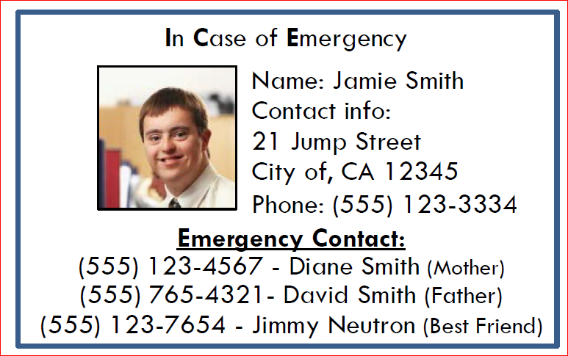
Number of people and/or organizations reached:
Open House –
37 IN CASE OF EMERGENCY CARDS Completed
In 2018 – 114
ICE Cards distributed
8 law enforcement agencies and 2 hospitals

Slide 4
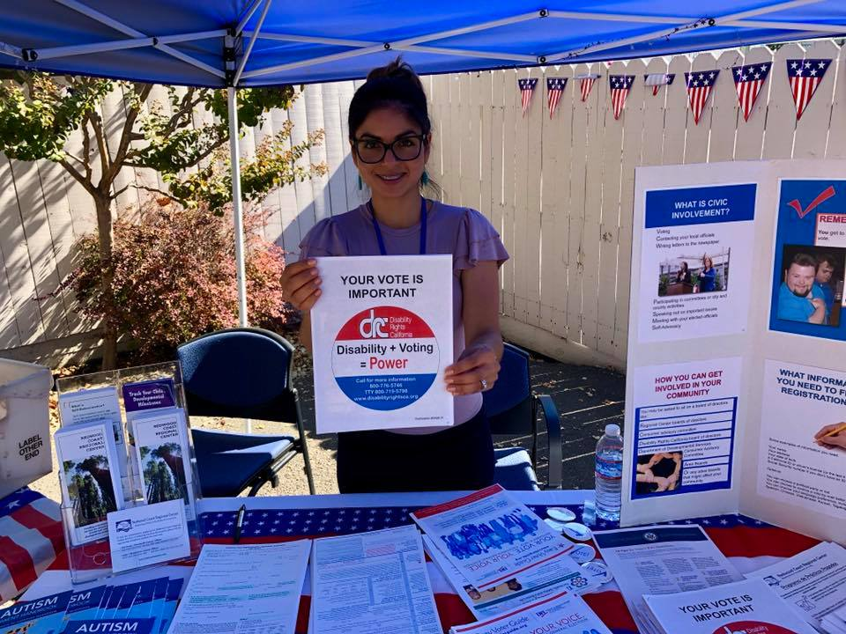
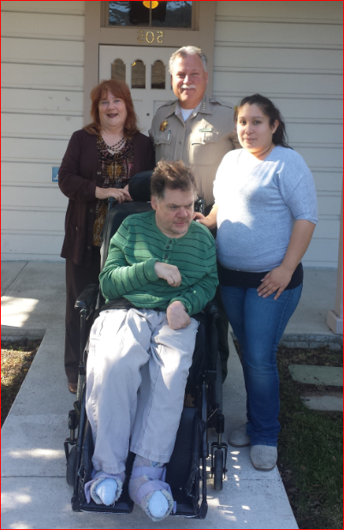
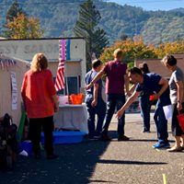
Collaborative Partners and/or Leveraged Funds:
Mendocino County Sheriff Department
Redwood Coast Regional Center
People First, Ukiah & Lakeport Chapters
U.V.H.A
People Services, Inc.
$3500 in Leveraged Funds for Card Printer and Supplies
Notes:
I am blessed to have an amazing colloborative

Slide 5
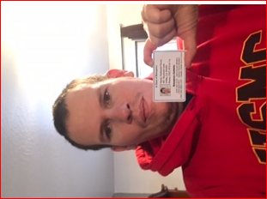
Thank you!
Project of Excellence
What’s the impact?
Introduced Public Safety Personnel to the needs of individuals with I/DD.
Promoted and strengthened relationships with emergency responders.
IN CASE OF EMERGENCY CARD Tool - Reinforced a crisis prevention approach from a possible crisis intervention.
Nate Florez -
North Coast SSAN Member
Notes:
Public safety and legal systems personnel have limited experience with and knowledge of people with disabilities. One study found that law enforcement officers accurately identified individuals with I/DD only 30% of the time, although many were confident in their ability to identify I/DD based on physical appearance alone (Douglas & Cuskelly, 2012).
During investigation and first contact a disproportionate number of people with I/DD give false confessions and many do not understand their Miranda and other legal rights (Smith, Polloway, Patton, & Beyer, 2008).

