Slide 1
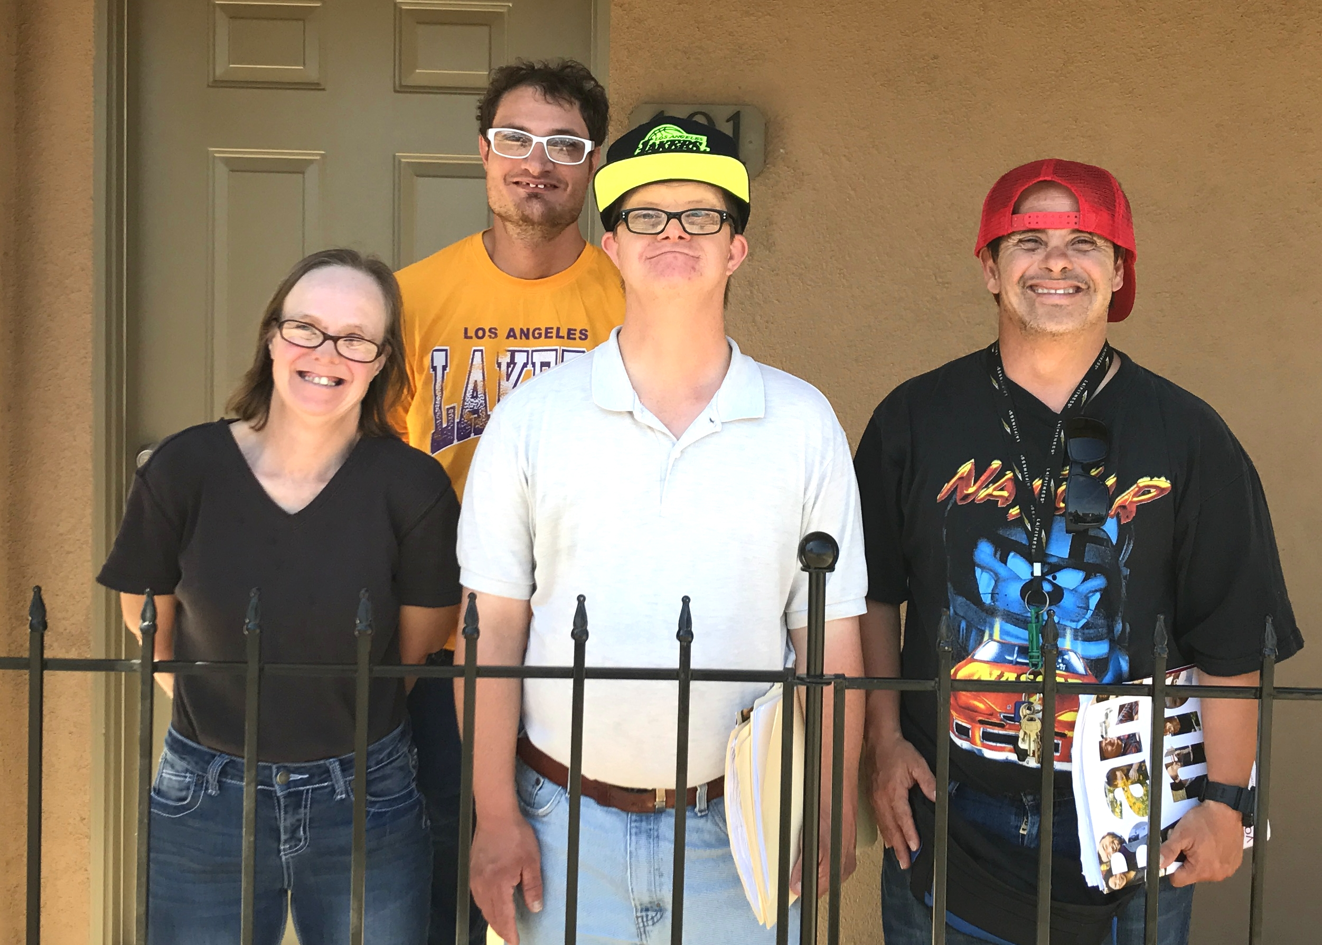
STATEWIDE STRATEGIC FRAMEWORK
for Expanding Housing Opportunities for People with Intellectual and Developmental Disabilities

Slide 2
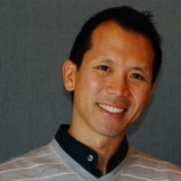
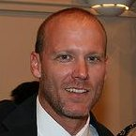
Presenters
Darin Lounds
Executive Director, HCEB
Vice President, LHA
Steven Shum
Associate Director, CSH
Ian Nevarez
Mgr. Comm. Rel., HOPE
Administrator, LHA
Patty Evans
Consultant

Slide 3
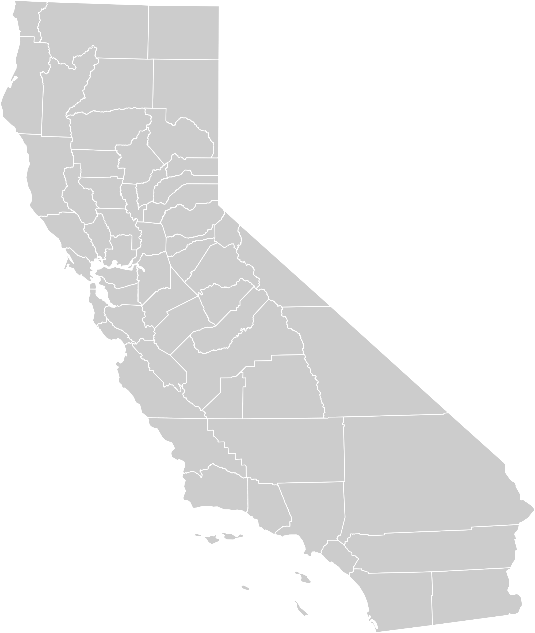
Scope of Presentation
Process Year-long Initiative
Product Tools and Recommendations

Slide 4
Lanterman Housing Alliance
STATEWIDE
Mission
History
Activity
Integrated Health & Living Project
Notes:
Mission
The Lanterman Housing Alliance fosters innovative public policies and public-private partnerships that result in sustainable investment in affordable housing for people with developmental disabilities.
History
We are an industry association founded in 2014, but our members have collaborated together, advocating for housing to serve this population for more than a decade.
Activity
Hold a bi-annual Housing Thought Leaders Summit
Publish newsletters and resources specific to housing people with I/DD
Coordinate committees on LHA core initiatives
“We serve as the bridge between the silos of the DD Service System and the Mainstream Housing Industry”
ANECDOTES ABOUT DISCONNECT…
Predevelopment
Education
Information
Needs
Partnerships
Development
Licensed Homes
Affordable Housing
Set-Aside Units
Legacy Homes
Housing Services
Access
Retention

Slide 5
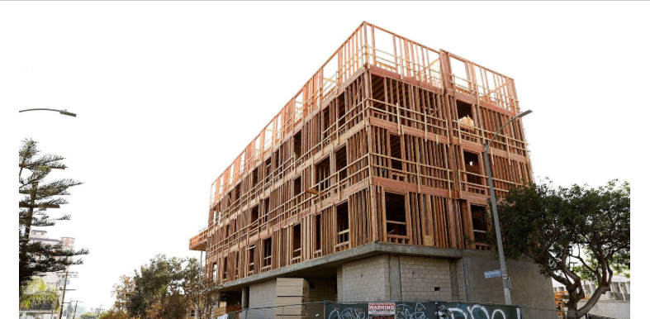
Why a Strategic Framework?
The affordable housing crisis disproportionately affects people with I/DD.
Addressing the Housing Crisis
Veteran
Homelessness & Mental Health
Developmental Disabilities
VASH, VHHP & Prop 1 (VAHF)
Measure H, HHH, Prop 2 (NPLH)
No Legislation or Ballot Initiatives

Slide 6
Corporation for Supportive Housing
NATIONAL
Mission
History
Activity

Slide 8
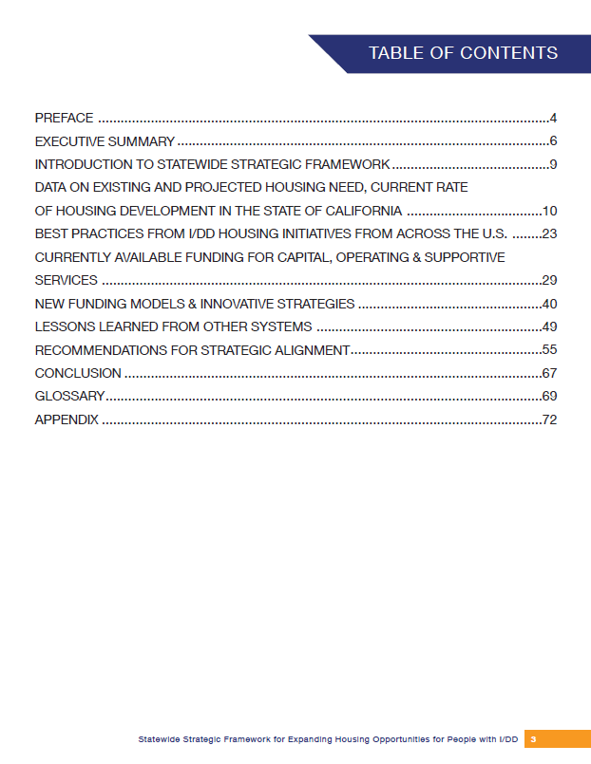
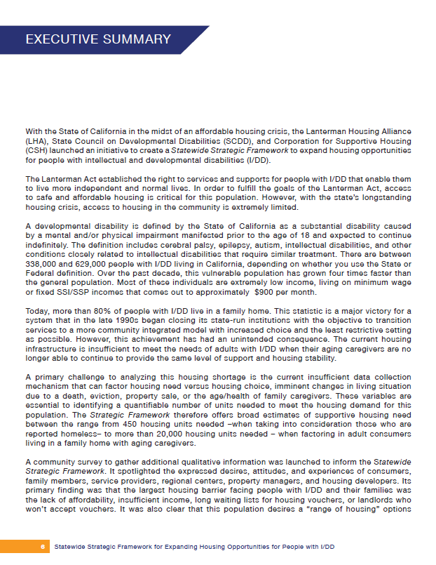
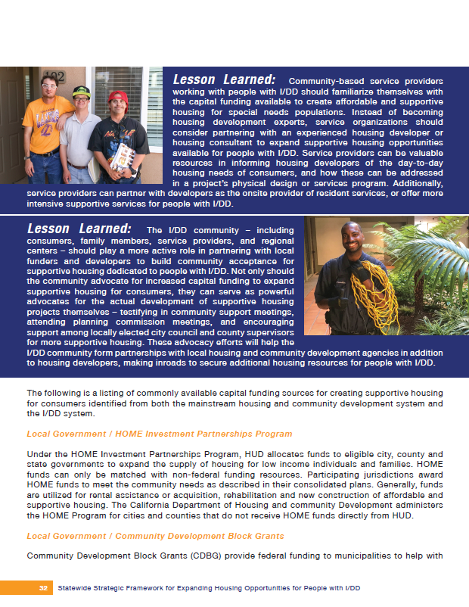
SSF Content & Structure

Slide 9
SSF Findings
Data on Need & Current Rate of Housing
Best Practices from Other States
Current & Innovative Funding
Lessons Learned from Other Systems
Recommendations

Slide 10
What’s Next?

Slide 11
Q&A!

