Slide 1
Self-Determination Training for RC SDAC Volunteers
Paul Billodeau, Executive Director Valley Mountain Regional Center
Dena Hernandez, Manager
SCDD/ North Valley Hills Office
June 30, 2015
Valley Mountain Regional Center
Stockton Office
3pm-4pm

Slide 2
Acronyms Used
CMS = Centers for Medicare and Medicaid Services
DDS = CA Dept. of Developmental Services
FH = fair hearings
PCP = Person-Centered Planning
RC = Regional Center
SCDD = State Council on Developmental Disabilities
SD = Self-Determination
SDAC = Self-Determination Advisory Committees

Slide 3
What We Will Cover
Self-Determination
What it is, how it works, roles, and related issues
Role of the Self-Determination Advisory Committees
Statewide SDAC
DDS SD Workgroup

Slide 4
What We Will Cover
SDAC Dynamics
Miscellaneous issues such as parliamentary procedure, meeting schedule, etc.
Possible issues for the SDACs to initially tackle
Anticipated challenges

Slide 5
What Is Self-Determination?
Huge change in the law
New option
Voluntary
Regular RC services vs.
SD services
Handout

Slide 6
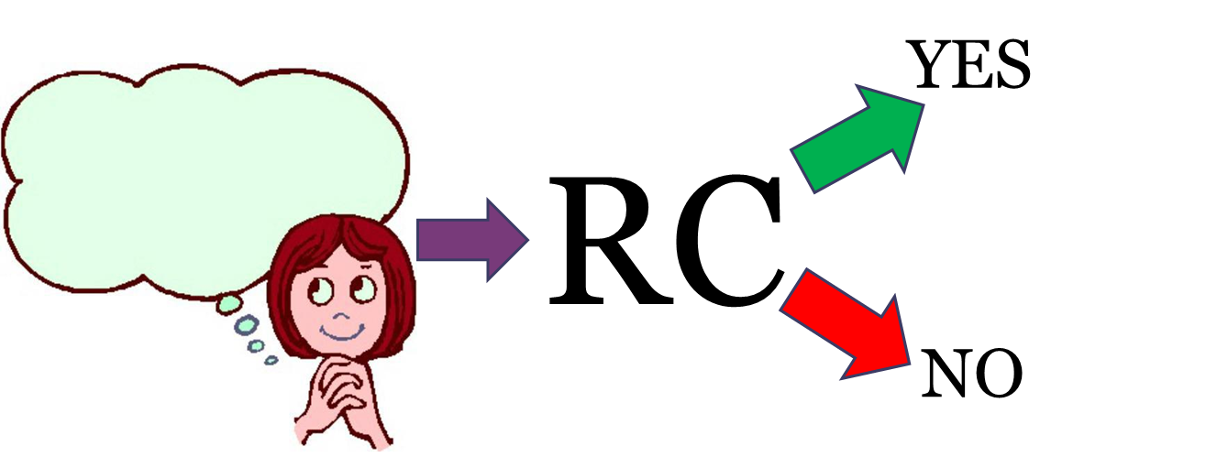
Regular RC Services

Slide 7
Self-Determination Services

Slide 8
Principles of Self-Determination
Freedom
Authority
Support
Responsibility
Confirmation

Slide 9
Eligibility
Have a RC case under the Lanterman Act
Live at home or in community
Not eligible if you live in some kinds of long term care facilities, unless you are in the process of moving into the community
Be willing to receive training and comply with the program’s rules

Slide 10
The Budget
Based upon the cost of services used in the previous 12 months
May be adjusted based on:
Changing circumstances
Unaddressed or unmet needs
“The RC certifies on the individual budget document that RC expenditures for the individual budget, including any adjustment, would have occurred regardless of the individual’s participation in the Self-Determination Program.”
New to the system, no previous 12 month history
10% of the funds can be shifted

Slide 11
The Process and The Players
Person-Centered Planning (PCP)
You, the person with a RC case
RC
Facilitator
Training
Fiscal Manager
Your friends, family, staff, paid supports, etc.
Criminal background checks, fingerprinting, etc.

Slide 12
Timelines
Once the waiver is accepted by CMS, the waiver must be approved within 90 days
Questions versus resubmissions
Once the waiver is approved, implementation of the SD Program will begin
Three years after that anyone may participate in the SD Program

Slide 13
Is SD Right for Someone?
Ask these six questions:
Do you have a complicated life?
Have you had a lot of denials, fair hearings, and conflicts with RC?
Have you lost services due to changes in the Lanterman Act or budget cuts?
Do you need or want unique services not typically available through RCs?
Do you want to start a business, get good work training or get a good paying job?
Are you ready to take on the responsibility?

Slide 14
A Historical Context
SD Pilot Programs
How they worked compared to the current self-determination program
Outcomes

Slide 15
Role of the SDAC
Composition of the SDACs
Objectives
To ensure the work is getting done, not to do the work
Statutory requirements [WIC §4685.8(x) and (x)(1)]
Provide oversight of the Self-Determination Program
“The committee shall review the development and ongoing progress of the Self-Determination Program, including whether the program advances the principles of self-determination and is operating consistent with the requirements of this section, and may make ongoing recommendations for improvement to the regional center and the department.”

Slide 16
Other Advisory Committees
SCDD’s Statewide SDAC
Membership is the chair or each group or their designee
At least twice per year
“to identify self-determination best practices, effective consumer and family training materials, implementation concerns, systemic issues, ways to enhance the program, and recommendations regarding the most effective method for participants to learn of individuals who are available to provide services and supports. The council shall synthesize information received from the Statewide Self-Determination Advisory Committee, local advisory committees, and other sources, shall share the information with consumers, families, regional centers, and the department, and shall make recommendations, as appropriate, to increase the program’s effectiveness in furthering the principles of self-determination”
DDS’ SD Workgroup

Slide 17
Committee Dynamics
Issues, not people
Supporting others
Dealing with opposing perspectives
Gaining consensus

Slide 18
SDAC Housekeeping
How often and when it meets
Structure
Election of Officers
Parliamentary procedure
Miscellaneous

Slide 19
Initial Issues to Consider
Soft roll out
2500 participants during the three year phase-in period
How participants will be selected
Attend mandatory informational meeting
RC must contract with a local family-run organization to conduct outreach

Slide 20
Possible Challenges
Resistance
From multiple sources
People with disabilities
Families
Vendors
RCs
Getting accountability

