Slide 1
California
Able Act
(Achieving a Better Life Experience)
Presented by
Statewide Self Advocacy Network
Updated 3/16/17

Slide 2
This information is from the CalABLE Act Board
THIS IS AN OVERVIEW PRESENTATION….
CalABLE ACT has a Board that is working on how to get things started in California!
More information and details will be coming out as things get started.
SSAN suggests that YOU check out the website http://www.treasurer.ca.gov/able to stay up to date on all the details and rules of this exciting opportunity!

Slide 3
ABLE ACT… What YOU should know after this presentation…
What the ABLE Act is;
How YOU qualify for an ABLE Account;
How much can YOU save in an ABLE Account;
What YOU can spend the money on from your ABLE Account;
How to spend YOUR money from your ABLE Account;
What are some benefits of an ABLE Account;
Where YOU open an ABLE Account, and;
Resources for YOU to get more information.

Slide 4
What is the ABLE ACT?
A federal law that the President signed in 2014;
The law says it is to provide a greater financial security to people living with a disability through an ABLE savings account;
Each state is able to create tax-advantaged savings accounts for people with disabilities while protecting eligibility for public benefits like SSI, SSDI or Medicaid.

Slide 5
How do YOU Qualify for an ABLE Account?
Must have a disability before the age of 26 AND
Meet the eligibility criteria for disability benefits like SSI or SSDI- OR
Self-certification: been diagnosed by a doctor with a physical or mental disability resulting in severe limitations that is expected to last no less than 12 months.

Slide 6
How much can YOU save in an ABLE Account?
Before the ABLE Act, YOU could only save $2,000 each year before impacting your benefits.
YOU can now save up to $14,000 each year and up to $100,000 in total before impacting your SSI benefits.
YOU can only have ONE ABLE Account.
ABLE Accounts are not subject to federal or state income tax

Slide 7
What can YOU spend the money on from your ABLE Account?
The money in an ABLE account MUST be used/spent for certain Qualified Disability Expenses, like:
Daily living expenses
Education
Housing
Transportation
Help getting and keeping work
Health care
Assistive technology
Legal and Financial Management fees
And other expenses that improve or maintain the quality of your life!

Slide 8
How to Spend YOUR money from YOUR ABLE Account
Some ABLE programs offer debit cards and/or prepaid cards
You can use that card to pay for qualifying expenses. You can add a certain amount of money to the card each month
For things like rent: money has to be spent in the same calendar month you withdrew it.
It’s YOUR job to make sure your expense qualifies and to keep records of how use your ABLE account.
Don’t just hold onto the money YOU withdrawal or put it in a normal bank account – if you don’t spend the money, it could be counted as a resource for benefits programs.
EXAMPLE: if you take $3,500 out of an ABLE account and put it into a regular checking account instead of spending it, you will go over the resource limit for SSI.
As long as the money stays in the ABLE account, it won’t affect your benefits, so leave your money there until you need to spend it.

Slide 9
What are some benefits of an ABLE Account?
Ability to have money go directly from your bank account to your ABLE account.
Invite friends and family to contribute to your ABLE account.
Make online and check deposits
Low fees

Slide 10
Where can YOU open an ABLE Account?
YOU may open an ABLE Account outside the state you live- there are 21 ABLE States- 17 of these are national plans, where you do not have to be a resident of that state to open an ABLE Account. You can go to the ABLE Alliance for Financial Empowerment website: https://www.theablealliance.org/compare-page if they want to compare programs.
The California Program is in its development phase as and hopes to “go live” in the
Fall of 2017!

Slide 11
What’s NEXT?
If the Able Act sounds like something you would like to be part of, talk with your family and/or your service coordinator for support.
Learn all you can about the ABLE Act- remember CalABLE is supposed to “go live” in the FALL of 2017- but you can open an ABLE Account in another state in the meantime.
Start Saving for YOUR future!

Slide 12
RESOURCES
Check out these resources for more information:
www.treasurer.ca.gov/able
http://www.scdd.ca.gov/ssdac
www.disabilityrightsca.org
www.achievingindependence.com/able/

Slide 13
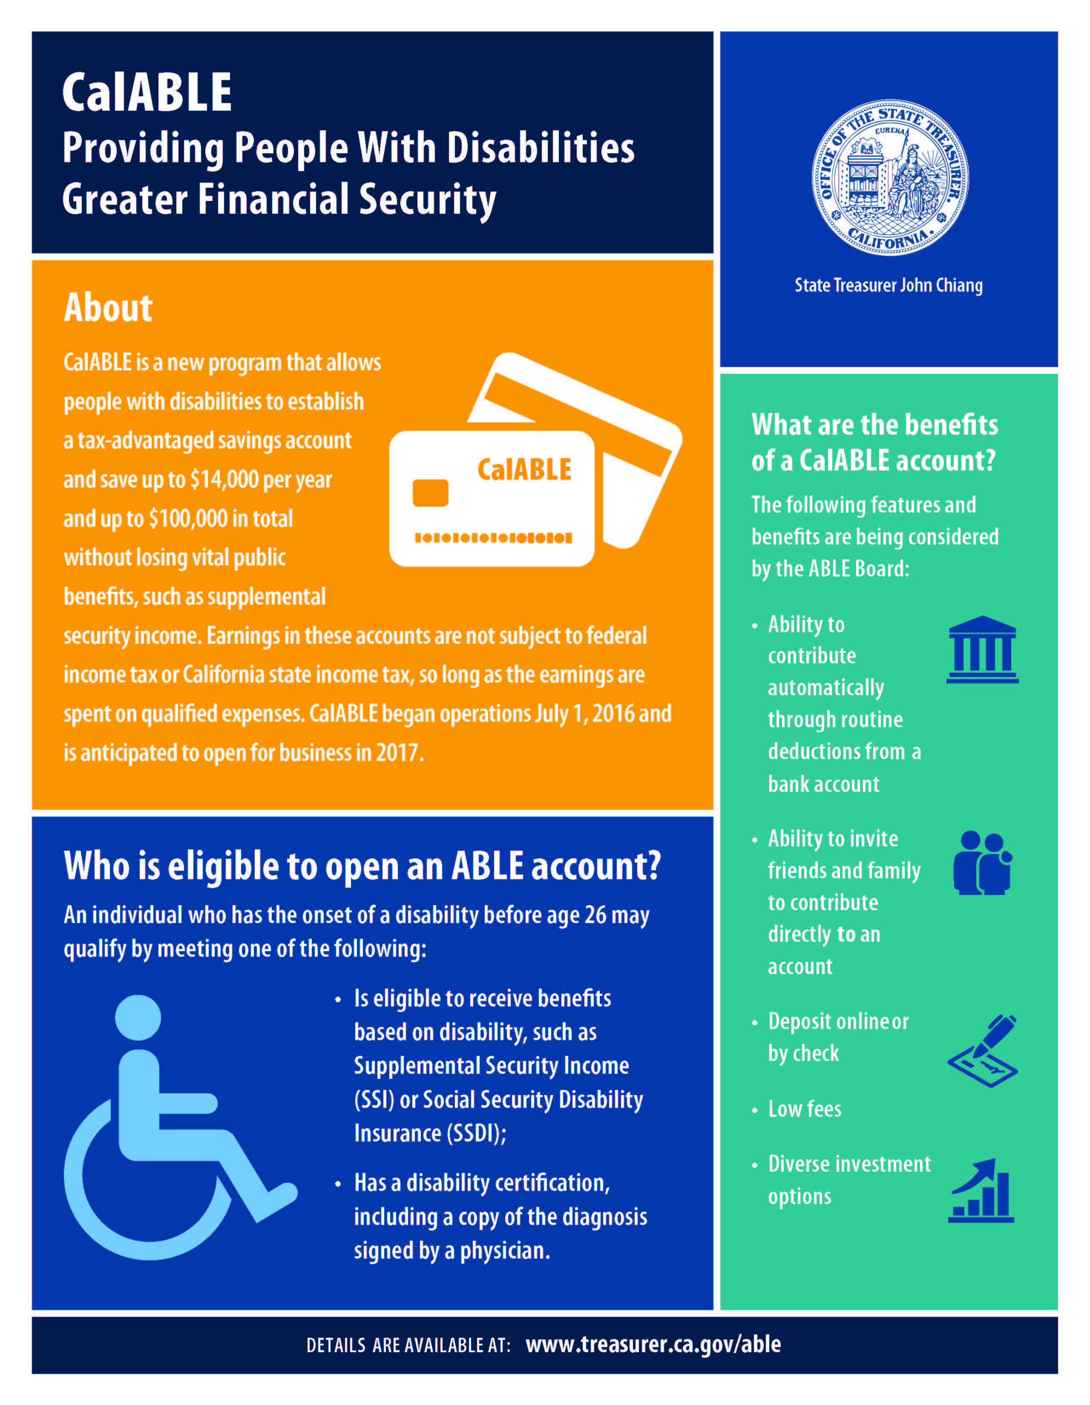
CalABLE FACT SHEET

Slide 14
QUESTIONS?

Slide 15
Thank YOU from SSAN

